Slide 1
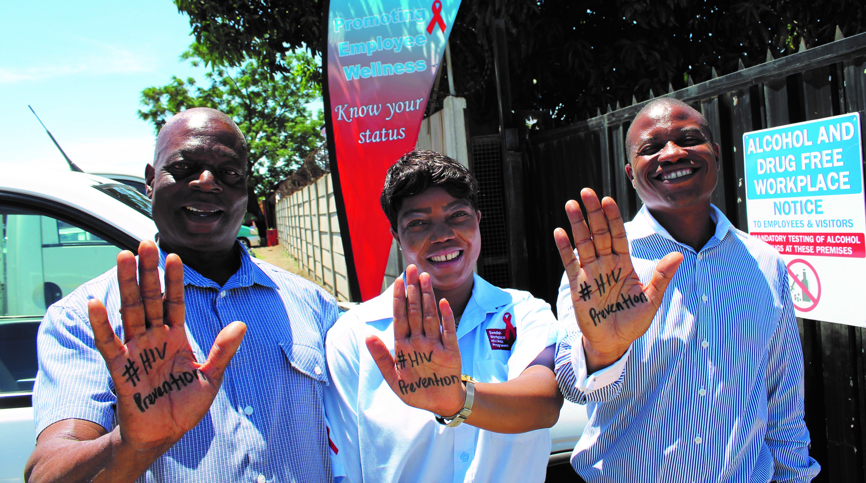
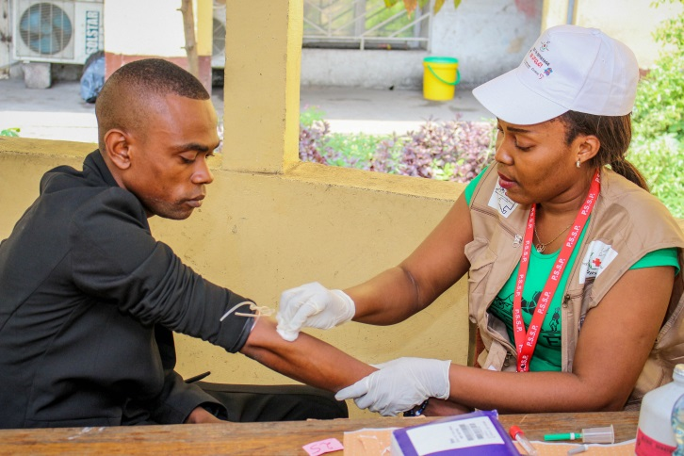
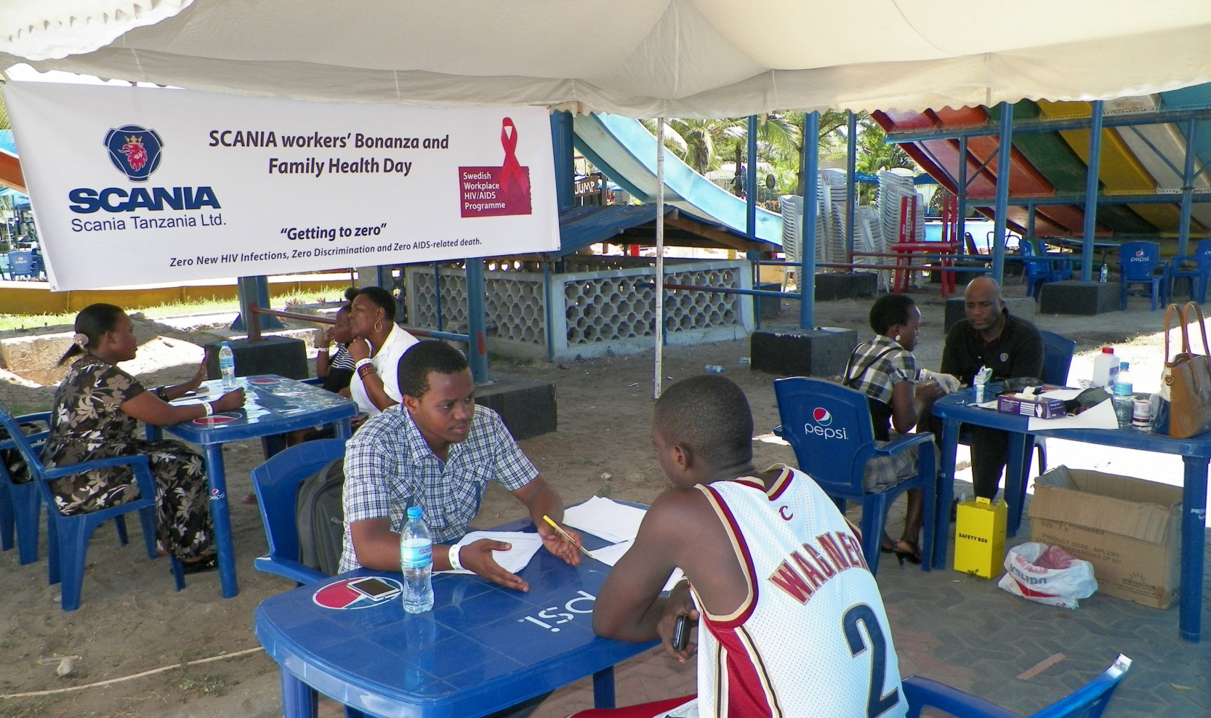
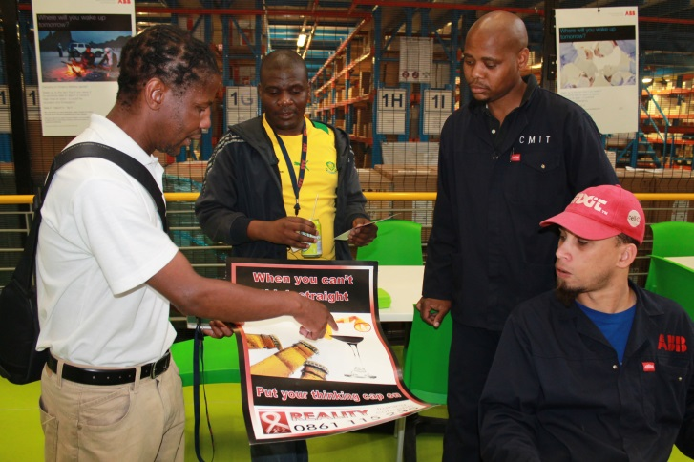
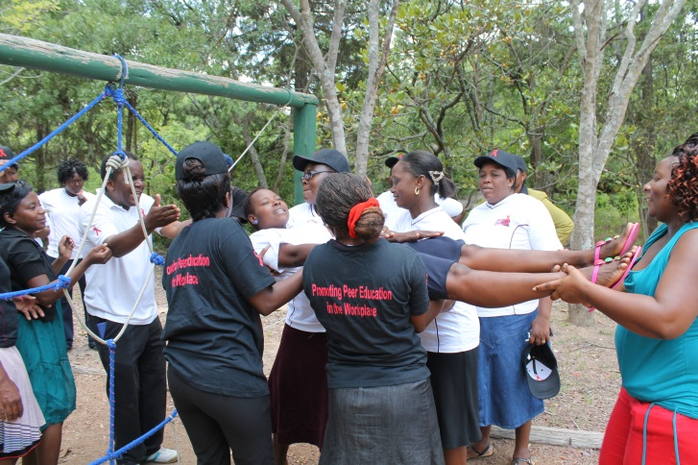
ACHIEVING SUSTAINABLE WORKPLACE HIV & AIDS PROGRAMMES THROUGH A PHASED OUT CATALYTIC FINANCING MODEL; THE CASE OF SWEDISH WORKPLACE HIV AND AIDS PROGRAMME IN SUB- SAHARAN AFRICA

Slide 2
PUBLIC PRIVATE PARTNERSHIP
Public Sector
Private Sector
NIR is an independent non-profit organisation representing Swedish Industry. Members include multinationals with operations in sub- Saharan Africa.
The Swedish Industrial and Metalworkers’ Union has 320,000 members at more than 12,000 workplaces, affiliated to 37 local branches.

Slide 3
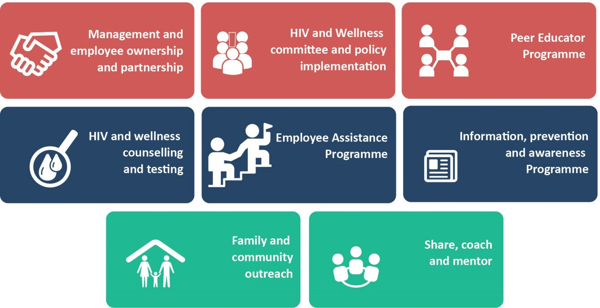
SWHAP APPROACH & FINANCING MODEL
HIV

Slide 4
SWHAP MODEL: INVESTMENT ANALYSIS
HIV

Slide 5
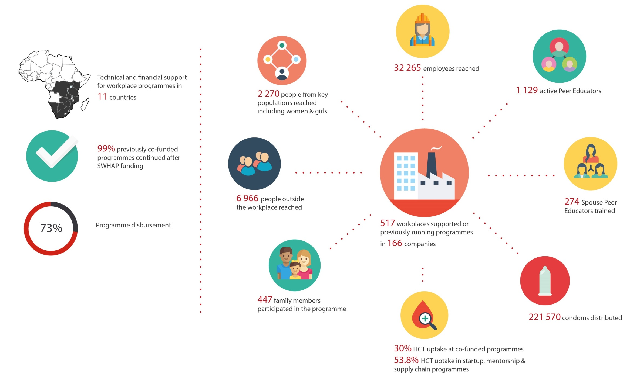
SWHAP IMPACT IN 2017
HIV

Slide 6
LESSONS
99% of companies funded through the three phases have sustained their programmes.
Catalytic model for increased investment and sustainable Programmes
Provides good value for money:
Reduction in costs for companies
Improved productivity
Reduced turnover
Transfer of knowledge to families and communities
Private sector contribution to national HIV and AIDS frameworks
Protection of human rights of workers through policies
Improved management/Workers’ relations through better dialogue reducing stigma and conflict - influencing and improving general work environment.
Effective Mentorship model
KAROLINSKA INSTITUTET STUDY, SWHAP SA
Among 1000 employees and at an annual cost of 300,000 South African rand (ZAR) the Programme is predicted to avert an average of 20.84 HIV infections per year.
Net Benefit = R134.42
Benefit Cost Ratio = R1.45
ROI = 44.8%

Slide 7
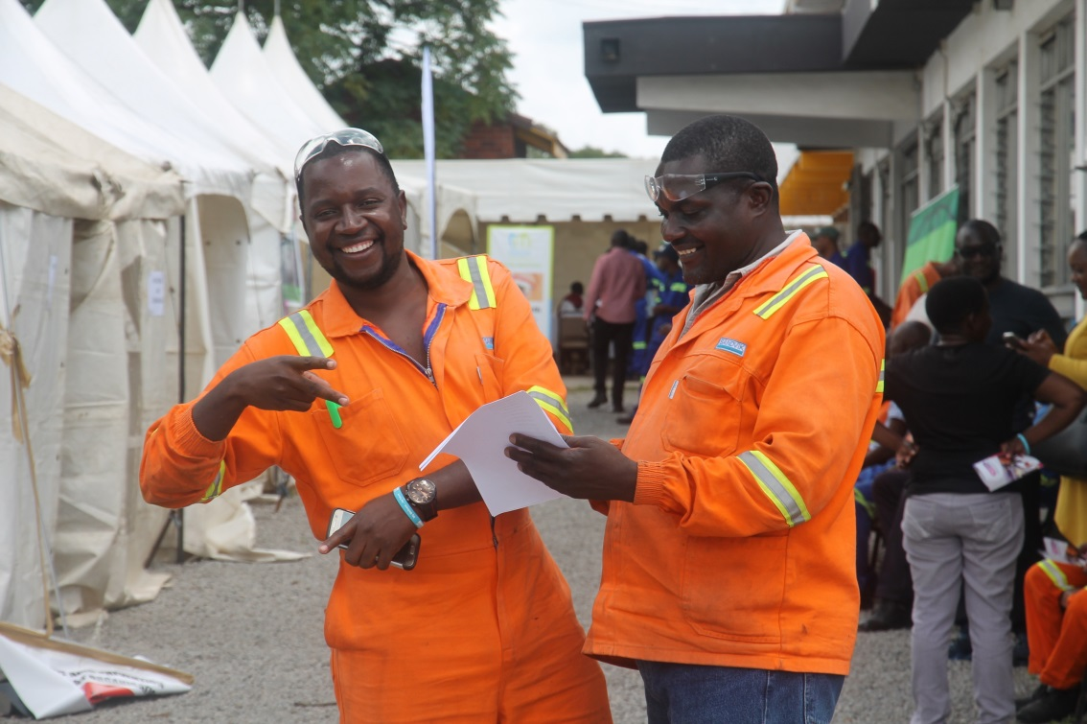
WAY FORWARD
Spread experience, Inspire others
Mentorship programmes
Lessons for informal sector?
Model: an advocacy tool
Model infrastructure for other programes in line with SDGs
HIV

